Slide 1
Solar Energy Solution
By: Md Mehsan Maharib and Muneeb Azher

Slide 2
Background
Develop a software model for determining the best solution for solar panel and battery placements in a constrained cartesian grid
Requires consideration of all feasible solutions and optimizing the model to determine the best solution(s)
The best solution must have the most green energy and optimal cost efficiency

Slide 3
Our approach
We started by calculating the average amount of sunlight each point on the grid gets in a day
The points with the highest avg. values would be the locations for solar panels since on any given day they receive the most amount of sunlight
Then we considered power demand per day by taking the riemann sum of P(t) over 100 ticks. The difference between the daily power demand and power generated by the solar panels would be allocated to power stored in the batteries.
The batteries contain power gained from buying energy and any excess energy that was stored from solar panels

Slide 4
Our Approach
To calculate the power generated by the solar panels we first chose a number of grids that receive the most average sunlight.
Next we place solar panels on these grids and based on how much sunlight they received on a day on average we calculate the power they generate.
The sum of the power generated by al the panels gives us the total power generated solely using solar panels.
Next we take the difference between the total required power for a day and the power generated by the solar panels.
This difference needs to be mitigated with the help of batteries and by buying energy.

Slide 5
Our Approach
On this step we first calculated how many batteries were required by using the total power that needed to be generated.
Next using the given equation the total cost of buying the batteries and the cost of the energy that was bought was also calculated.
Next the cost of batteries, energy that was bought and also the cost of the solar panels were all added to determine the final cost of the project.

Slide 6
Design
We wrote algorithms in python to calculate the parameters in each data set of grid points
These parameters include:
Daily Power Demand
Average sunlight for each point throughout the entire day
Number of panels that should be placed
Coordinates of points where panels should be placed
Battery storage and number of batteries needed

Slide 7
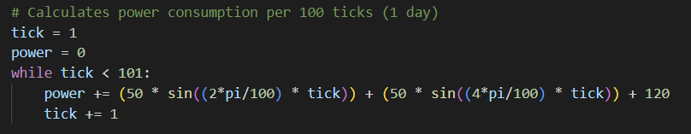
Implementation
Power Demand, P(t)

Slide 8
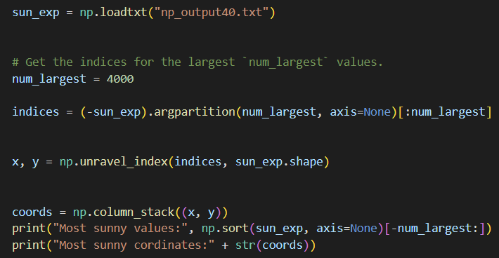
Implementation
Greatest amount of panels

Slide 9
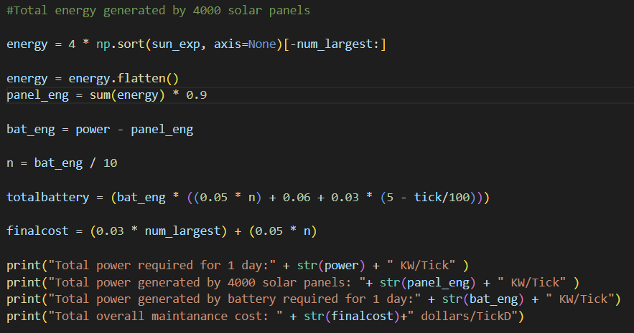
Implementation
Battery energy
Error correction factor
Number of Batteries
Battery cost

Slide 10
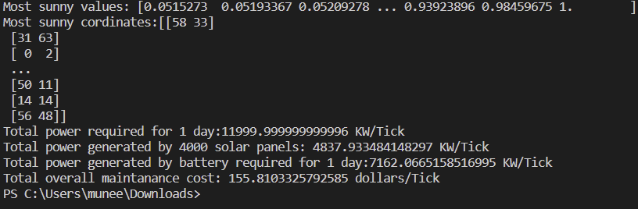
Final Results
4000 grid points with greatest sun exposure
y - coordinate
x - coordinate

Slide 11
Advantages & Limitations
The advantages of programming in python include the simplicity of executing programs (typically small scale)
Working with large data sets can negatively impact the run time of the program, hence the need to sort and extract
We needed to calculate all points (64 x 64 x 100 ticks= 409 600 calculations) and that increases chances of errors.
Calculating values of such large datasets causes significant time delays and as such a sample tick was chosen from the data provided to be used as the average dataset for sunny areas

Slide 12
Suggestions
For interactivity, a application page with a user input of data, along with a display of panel locations, cost, energy and power consumption would be ideal.
More time for testing refining the code is recommended.
It is possible that multiple solar panels can be fitted into a single grid box and more research should be done on this.

Slide 13
THANK YOU ALL FOR LISTENING! QUESTIONS?

